Slide 1
Exploring Data With Bloons!
By Colin Watson

Slide 2
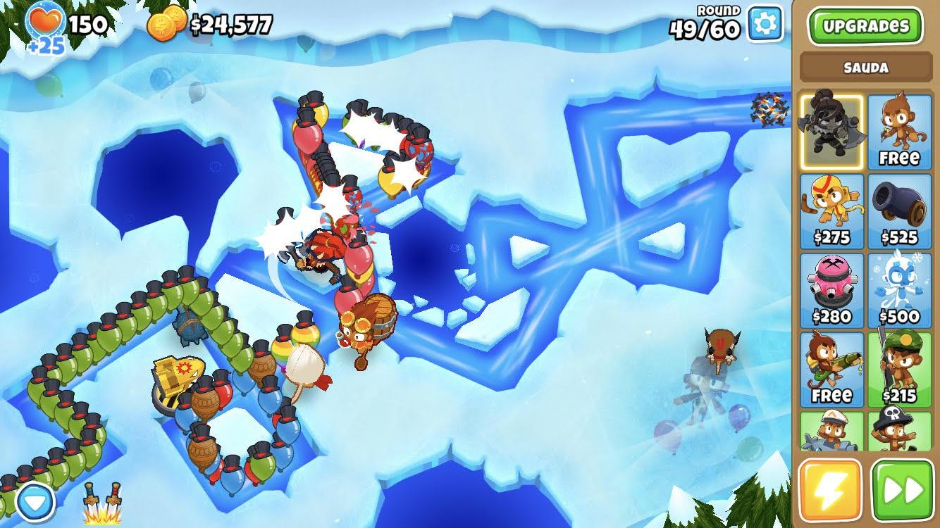
What is Bloons TD6?
Bloons Tower Defense 6 is a game created by Ninja Kiwi in 2018
It is a game where bloons move through preset tracks, and the player must place various towers to pop the bloons before they reach the end of the track
Each bloon you pop gives you one dollar to spend on upgrading your monkeys
I promise you are not going crazy, bloons is misspelled
Image from me!
A simple defense on the map Frozen Over

Slide 3
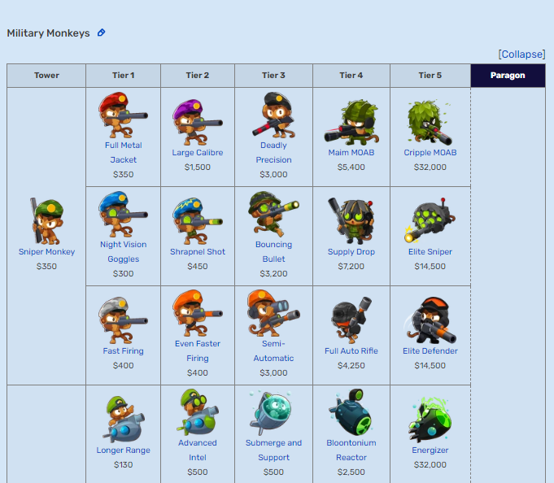
The Question
Each upgrade costs a different amount, and they can vary greatly in power.
While it is difficult to accurately compare upgrades of different towers together, it is much easier to compare upgrades when looking at the costs.
I want to find what the average upgrade costs, which can be used as a baseline for further comparisons
* Most non-standard game modes restrict towers in some way,
but that is beyond the scope of this presentation
Image from the BTD6 Fandom Wikipedia
The wikipedia article of all upgrades in BTD6

Slide 4
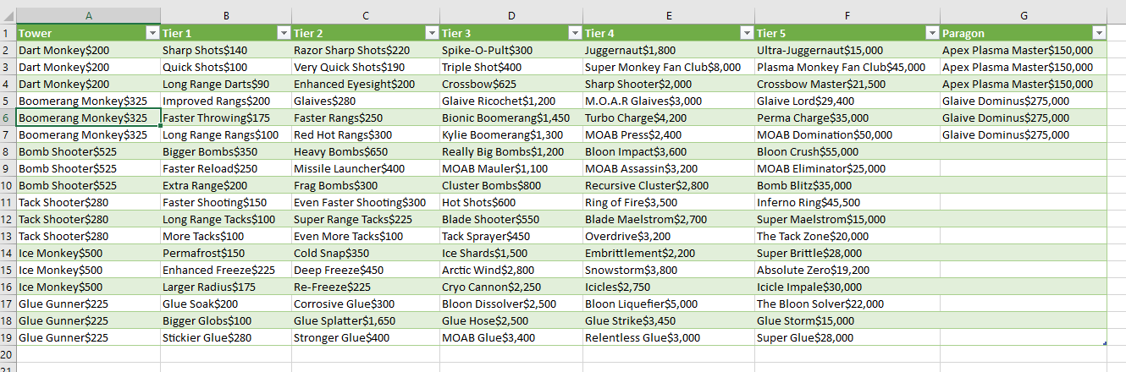
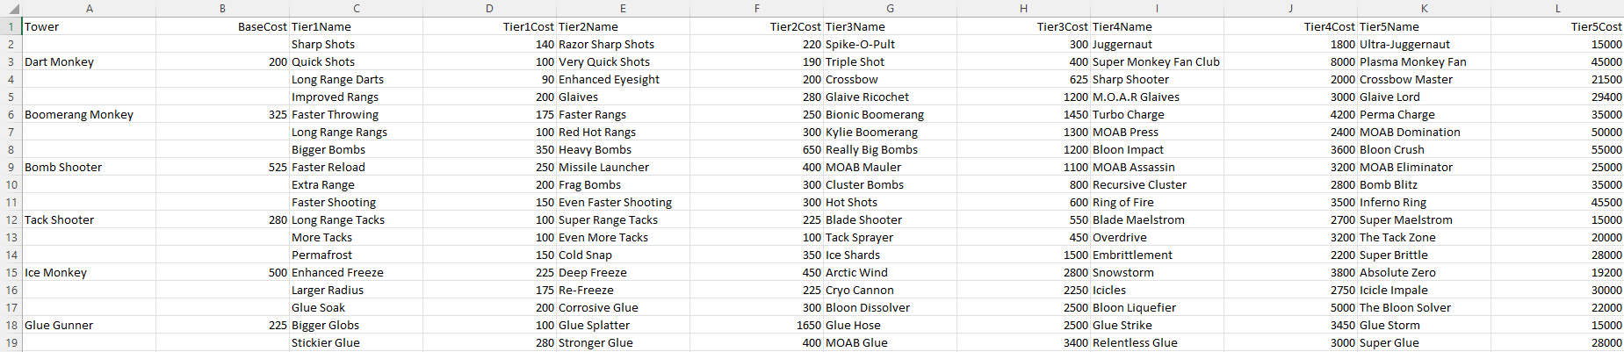
Getting the data
The data for this project was sourced from the Bloons TD6 Fandom Wikipedia, which got all its information directly from the game
I used Microsoft Excel’s web scraping tool to easily get the data into a table
However, the exported table was not great, so some time was needed to make the data usable.

Slide 5
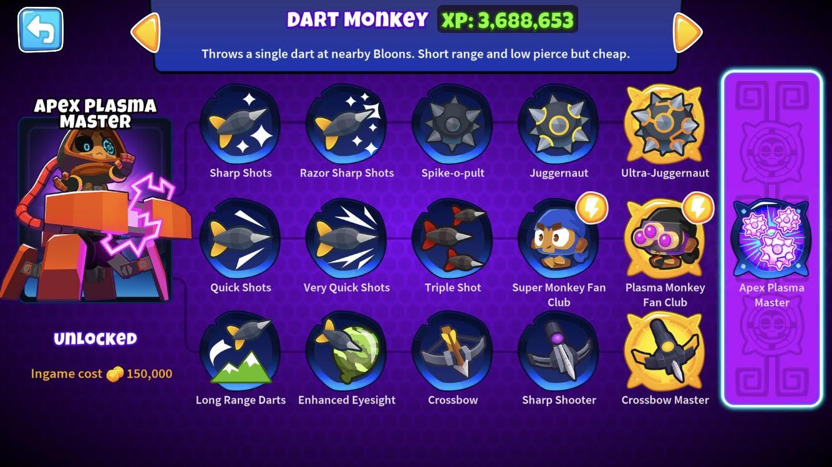
How do upgrades work?
Each tower has three upgrade paths with five tiers each, making a total of fifteen upgrade for each tower
Some towers have a Paragon, which is similar to a sixth tier.
However, these upgrades differ greatly from standard upgrades, and are beyond the scope of this presentation.
Image from me!
All upgrades of the dart monkey, including the paragon

Slide 6

Ethical Considerations
Since this data is from a video game and not real life, we don’t need to worry too much about ethics
All the data was sourced from publicly available information
The worst that can feasibly come from my research is people arguing on the internet, which is going to happen anyways
Image from Shutterstock.com

Slide 7
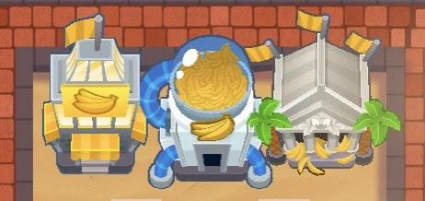
Some Fun Numbers
All base towers cost $15655
All tier 1s cost $25975
All tier 2s cost $41945
All tier 3s cost $166700
All tier 4s cost $612955
All tier 5s cost $3419600
All upgrades cost $4282830
It would cost $5725055 to get every single tower in the game on the same map
Image from me!
The three tier 5 Banana Farms
* All calculations are done excluding potential discounts, paragons and the Monkeyopolis, which has a variable cost.

Slide 8

Results
The average cost is $11638.125, which rounds down in-game to $11,635
Base towers is $680
Tier 1 is $375
Tier 2 is $605
Tier 3 is $2415
Tier 4 is $8880
Tier 5 is $49555
These values are similar to what I expected from my experience playing the game.
Stonks meme
Image from Insider.com

Slide 9
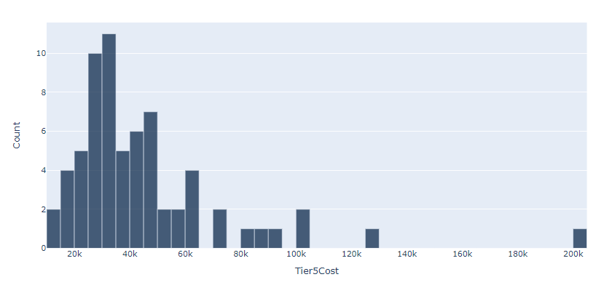
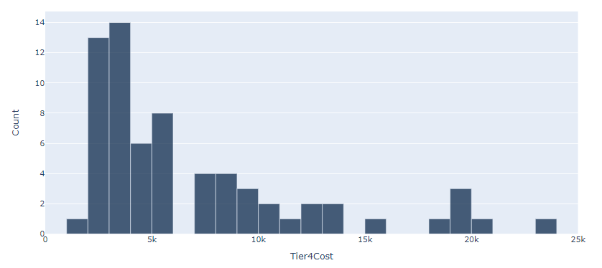
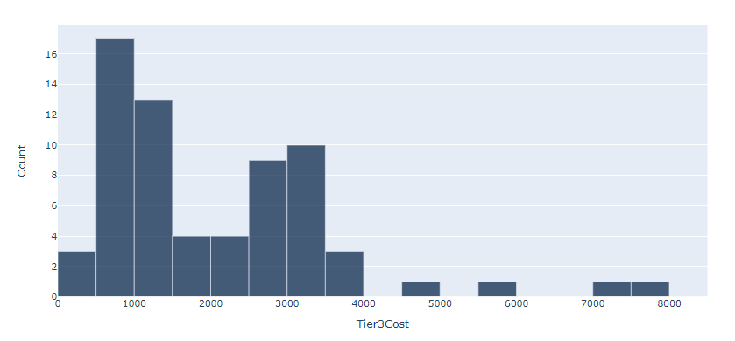
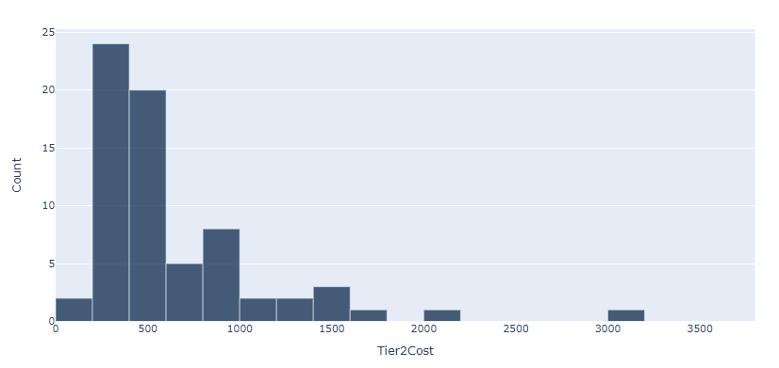
Graphs
Bin size of 5000
Bin size of 1000
Bin size of 500
Bin size of 200

Slide 10

The Conclusion
The values I got for averages make a lot of sense
It is nigh impossible to make comparisons using only this data
However, it is ready to be used as a baseline for further comparison
BTD6’s splash screen when loading.
Sorry about the low quality.
From NinjaKiwi

Slide 11
Thank you for
listening to me talk
about Bloons!

Slide 12
Sources
https://bloons.fandom.com/wiki/Upgrades
https://www.shutterstock.com/image-photo/portrait-man-yelling-into-megaphone-against-125429633
https://www.insider.com/stonks-meme-origin-stocks-dogecoin-gamestop-hold-line-memes-game-2021-1
https://ninjakiwi.com

